Slide 1
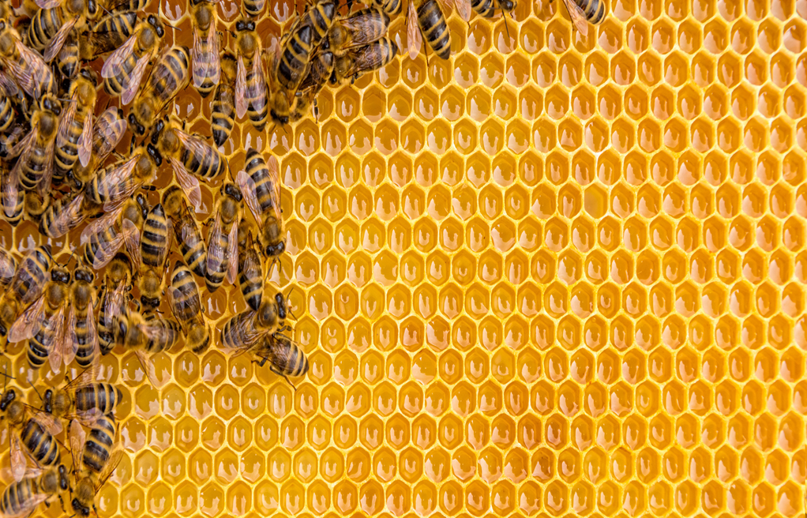
SanMelix Laboratories, Inc.
Bioactive Wound Care

Slide 2
Company Description
Faster and Healthier Healing
Bringing faster healthier wound healing outcomes to trauma, burn victims and diabetics using the natural and superior healing properties of buckwheat honey, combined with our advanced antimicrobial enhancements. Our patented BEECure™ M product has higher anti-inflammatory and anti-oxidant properties than the manuka honey-based products as well as higher standardization and broader spectrum anti-microbial activity. Our over-the-counter skin products are designed to help in the healing of minor burns, scrapes, radiodermatitis and more.

Slide 3
The Problem
Anti-microbial (AMR) Resistance Crisis
Diabetic Foot Ulcers (DFU)
Radiation, Chemical and Thermal Burns
Resistant infections currently kill 700,000+ people globally and is projected to increase to 10 million people per year by 2050¹.
Estimated 26 million patients develop DFUs globally which last 13 months and recur in up to 70% of patients resulting in 15% requiring amputations with 47% ending in death².
There are few effective therapies for radiotherapy, laser therapy and minor thermal burns. Of the 3 million patients receiving radiation 85% experience moderate to severe skin reactions³.
SanMelix Laboratories, Inc.

Slide 4
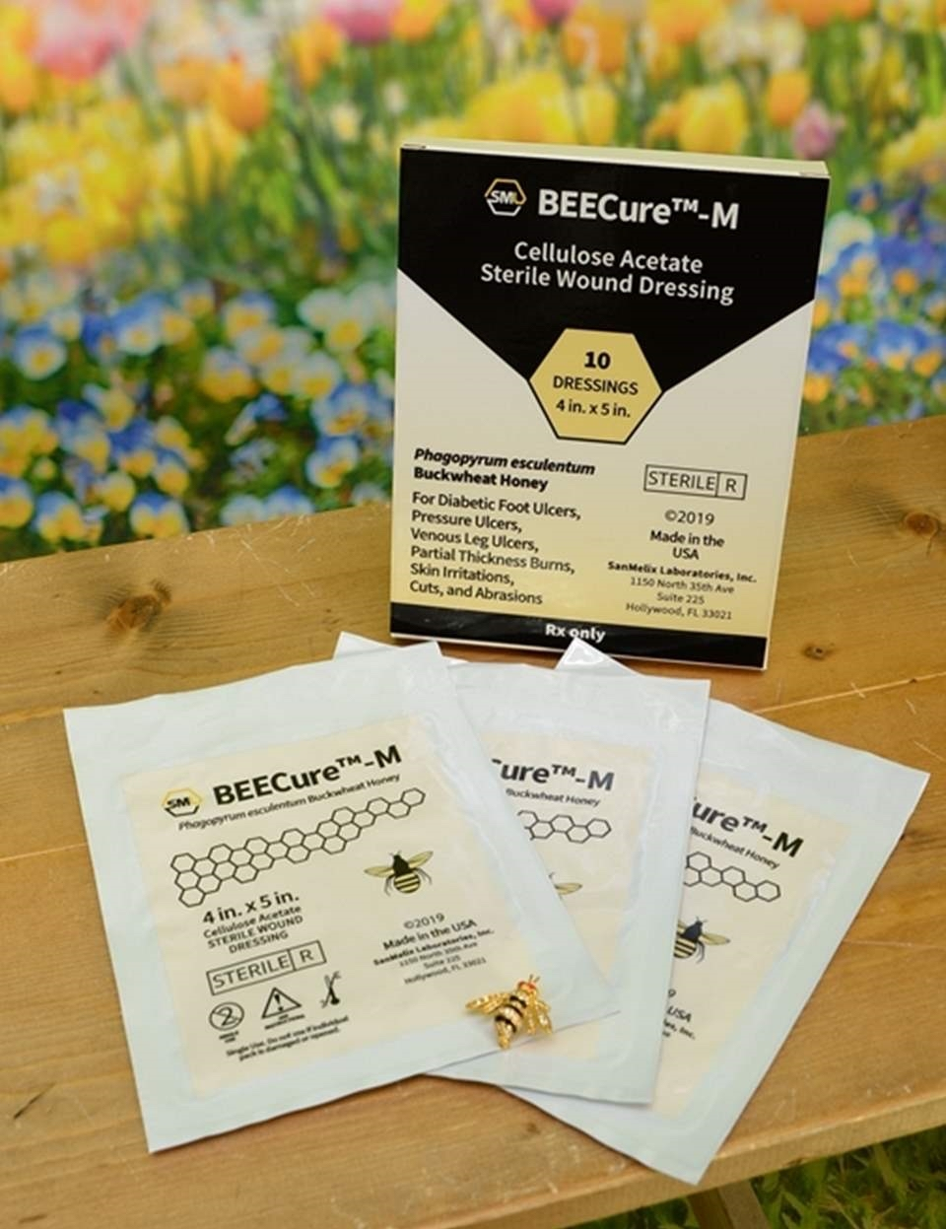
AMR Crisis
DFUs
Burns
Our BEECure™ M patented formulation provides a microbial barrier to prevent life threatening bacteria (MRSA) from penetrating the dressing⁴.
Case studies illustrated superior clinical outcomes with accelerated healing and skin regeneration on severe limb threatening wounds⁵.
Honey dressings make the wounds sterile in less time, enhance healing, and have a better outcome in terms of hypertrophic scars and postburn contractures, as compared to silver sulfadiazine dressings⁶.
SanMelix Laboratories, Inc.

Slide 5
Our BEECure™ dressing formulations were co-invented by Dr. Sabacinski, a renowned Harvard trained podiatric physician.
BEECure™ M:
Patent Allowed
Composition: Allowed
Method and Use: Patent Pending
BEECure™ I: Patent Pending
BEECure™ B: Patent Pending
Dr. Kenneth Sabacinski has established himself as a premier podiatrist in Hollywood, FL whose expertise focuses on the limb salvage of diabetic patients and related injuries and ailments. He is a board-certified physician with over 30 years experience in Foot & Ankle medicine, and surgery. Dr. Sabacinski has seen firsthand the need for the products we've been creating. He knows our BEECure™ dressings are going to be a big step forward in changing the lives of many.
IP Portfolio Has Created Barriers to Entry
SanMelix Laboratories, Inc.

Slide 6
Dr. Sabacinski has been involved with a limited amount of case studies (performed on an emergency off-protocol basis) with BEECure™ M to develop a buckwheat honey wound care based dressing for moist healing. Based on initial case studies combined with his antibiotic solutions, Dr. Sabacinski found that the buckwheat honey-based dressing enhanced and hastened healing in the treatment of severe limb-threatening, non-healing wounds as follows:
Case 1: Nonhealing Left Transmetatarsal Amputation (TMA) Neuropathic Diabetic Ulceration. This severe limb threatening, non-healing, infected wound completely healed at 13 weeks.
Case 2: Posterior Right Heal Decubitus Neuropathic Ulceration with Osteomyelitis. Status Post TMA. Wound completely healed at twelve (12) weeks.
Case 3. Left Heel Ischemic Diabetic Neuropathic Ulceration with Infected Exposed Bone (Osteomyelitis of the Calcaneus). Recommendations from Internist and Vascular Surgeon was below the knee amputation (BKA). Wound completely healed at fifteen (15) weeks.
SanMelix Laboratories, Inc.

Slide 7
Characteristics of an ideal wound dressing ⁷
Autolytic Debridement
Provide moist environment*
Provide debridement action
Microbial Barrier Claim
Protect from bacterial infection*
Skin Regeneration
Enhance epidermal migration
Promote angiogenesis and connective tissue synthesis
Allow gas exchange between wounded tissue and environment (ROS)
Appropriate temperature to improve blood flow
Dressings
Non-adherent and easy to remove
Sterile, non-toxic, and non-allergic
*FDA Claims
OUR PATENTED TECHNOLOGY PROVIDES US WITH A SIGNIFICANT COMPETITIVE ADVANTAGE AS WE MEET ALL OF THE REQUIREMENTS OF AN IDEAL WOUND DRESSING
SanMelix Laboratories, Inc.

Slide 8
Autolytic Debridement
Moist Wound Environment
Low pH
Osmotic Pressure
SanMelix Laboratories, Inc.

Slide 9
Anti-microbial Properties
Osmotic Pressure
Low pH
Hydrogen Peroxide
Methylglyoxal
Polyphenols
Low water Activity
SanMelix Laboratories, Inc.

Slide 10
Advanced Skin Regenerationª
*Higher Antioxidant *Higher Anti-inflammatory *Higher Tissue Repair activity of fibroblasts
Superoxide Anion Scavenging^{b}
Inhibition of ROS Produced by Human PMNs^{c}
ª Data from van den Berg et al., 2008 ⁸
^{b} Antioxidant activity measured as the ability of honey to scavenge the highly reactive and toxic oxygen radical, superoxide anion
^{c} Anti-Inflammatory activity measured as the ability of honey to inhibit reactive oxygen species (ROS) produced by the inflammatory activity of human neutrophils
^{b} RIC50 = Reciprocal of IC50, the amount of honey per mL that achieves 50% inhibition.
SanMelix Laboratories, Inc.
Notes:
Skin Regeneration :
Talking points:

Slide 11
Microbial Barrier Claim
Mepilex AG- Silver
BEECure™ M
Aquacel Ag
Limited Effect on Skin Regeneration
Greater Effect on Skin Regeneration
Santyl
Autolytic Debridement
Medihoney
PROMOGRAN™
Derma-Gel Hydrogel
Tegaderm
No Microbial Barrier Claim
SanMelix Laboratories, Inc.

Slide 12
Segments:
Moist Wound Care
Antimicrobial
Active Wound Care
SanMelix Laboratories, Inc.

Slide 13
Based on our business model, the below highlighted amounts are our projected revenues and gross margin in year 2023;
% U.S. Market | Revenues (Total Market $3.6bn)
0.5% to 0.75% | $27,000,000
0.76% to 1% | $36,000,000
1.1% to 2% | $72,000,000
2.1% to 3% | $108,000,000
Gross Margin
15% to 35%
36% to 55%
56% to 75%
76%
* Advanced Wound Care Historical Market Value Multiplier 3x revenues *
SanMelix Laboratories, Inc.

Slide 14
2017
2018
Wound dressing samples produced
2019
BEECure™ M Patent issued
U.S. Air Force begins testing
FDA pre-submission 510(k) meeting
Two additional formulation Patents assigned to SanMelix BEECure™ I & BEECure™ B
SOW for FDA 510(k) testing with Air Force CRADA
Honey supply agreement executed
2020-2021
510(k) clearance BEECure™ M
510(k) clearance BEECure™ R
Reimbursement code
Evidence based Clinical Trials
Launched equity crowdfunding campaign
Previously raised: $565,000
Funding needed: $2,750,000
SanMelix Laboratories, Inc.
Notes:
Notes:
$750 and $2m

Slide 15
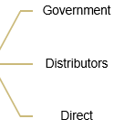
SOURCES AND USE OF FUNDS
$7M to $10M
Private or Public
$2M to $3M Private for Clinical Trials
$565,000 Initial Raise & CF
$130,000 Founders
Commercialization
Distribution
Evidence based Clinical Trials
Reimbursement Code
510(k) Clearances
Patent
Primary Evidence & Research
Valuation
SanMelix Laboratories, Inc.

Slide 16
Major AWC Companies
Surgical Suppliers
Major Drug Chains & Distributors for Private White Label
SanMelix Laboratories, Inc.

Slide 17
Board Members
Kenneth A. Sabacinski, CMO, DPM, MHS, FACFAS
Diana Sabacinski, CEO, Chairman, CPA, CFE
Hamid Khosrowshahi, Director Business Development
John Kaufman, Director
Samuel Hammer, Director, CPA, CGMA
Reimbursement & Government Affairs
Randall Carson Director of Reimbursement
Regulatory & Science
Barry Constantine, Research Scientist
Allison C. Komiyama, Ph.D.,
R.A.C.
Clinical
Dr. Jason Green, Advisory Board Dermatologist
Col. George E. Peoples,(Ret) MD
CRO
SanMelix Laboratories, Inc.

Slide 18
Invest IN the Ultimate Wound Dressing with IP Protection for its superior Healing Properties
www.startengine.com/sanmelix
SanMelix Laboratories, Inc.

Slide 19
FORWARD-LOOKING STATEMENTS
This presentation includes forward-looking statements within the meaning of the Private Securities Litigation Reform Act that reflect our current views with respect to, among other things, our operations, business strategy, interpretation of prior development activities, plans to develop and commercialize our products, potential market opportunity, financial performance and needs for additional financing. We have used words like "anticipate," "believe," "could," "estimate," "expect," "future," "intend," "may," "plan," "potential," "project," "will," and similar terms and phrases to identify forward-looking statements in this presentation.
Readers are cautioned not to place undue reliance on these forward-looking statements. Actual results may differ materially from those indicated by these forward-looking statements as a result of risks and uncertainties impacting SanMelix’s business, including the ability to predict future revenue associated; rate of growth; the ability to predict customer demand for existing and future products and to secure adequate manufacturing capacity; consumer demand conditions
affecting customers’ end markets; the ability to hire, retain and motivate employees; the effects of competition, including price competition; technological, regulatory/FDA and legal developments; developments in the economy and financial markets and other risks detailed from time to time in SanMelix’s filings with the Securities and Exchange Commission, including those described in our Form C as amended, filed with the SEC on June 19, 2019. Forward-looking statements speak only as of the date of this presentation, and we undertake no obligation to review or update any forward-looking statement except as may be required by applicable law.
SanMelix Laboratories, Inc.
Diana L. Sabacinski, CPA
Chief Executive Officer
(954) 605-4357
Dsabacinski@sanmelix.com
SanMelix Laboratories, Inc.

Slide 20
References
The Antimicrobials Resistance Crisis: http://www.antimicrobialsworkinggroup.org/antimicrobial-resistance/ working group:
Organogenesis: The Challenge is Real: https://organogenesis.com/advanced-wound-care/dermagraft/challenge-is-real.html?utm_source=woundsource&utm_medium=email&utm_campaign=lead_nuture_email_series_1 A Review: Advances in Wound Care VOL.4, No. 9 Published 3 Aug 2015: https://www.liebertpub.com/doi/10.1089/wound.2015.0635
Acute and Chronic Cutaneous Reactions to Ionizing Radiation Therapy: https://www.ncbi.nlm.nih.gov/pmc/articles/PMC4906114/ AACR Trends in Radiation Therapy Among Cancer Survivors in the United States,2000-2030: https://cebp.aacrjournals.org/content/cebp/early/ 2017/05/03/1055-9965.EPI-16-1023.full.pdf
Effect of United States Buckwheat Honey on Antibiotic-Resistant Hospital Acquired Pathogens: https://www.ncbi.nlm.nih.gov/pmc/articles/ PMC5326189
Case Studies: www.sanmelixlaboratories.com
Honey Dressing Versus Silver Sulfadiazene Dressing for Wound Healing in Burn Patients: https://www.ncbi.nlm.nih.gov/pmc/articles/PMC3263128
Wound Dressings—A Review: https://www.ncbi.nlm.nih.gov/pmc/articles/PMC4662938/
An In Vitro Examination of the Antioxidant and Anit-Inflammatory Properties of Buckwheat Honey: https://www.semanticscholar.org/paper/An-in-vitro-examination-of-the-antioxidant-and-of-Berg-Worm/b25557d331cc153d41368b7bd889b6e7d3378e81
Bioactive Wound Care Market to Reach USD 13.50 Billion by 2026: https://www.globenewswire.com/news-release/2019/05/16/1826492/0/en/Bioactive-Wound-Care-Market-To-Reach-USD-13-50-Billion-By-2026-Reports-And-Data.html
SanMelix Laboratories, Inc.

